Slide 1
Art and Architecture under Vijayanagar Empire
Vijayanagar Rulers were the saviours of Hindu religion.
Checked the invasion of the Muslims in the Tamil country
Protected the Hindu religion and Culture
Their Art, architecture, sculpture and painting were based on Hindu features.
Constructed many new temples and renovated the old temples in grand manner.
During this period Amman Shrine were built on the south-west corner.

Slide 2
Beautified the pillars of the temples
Build very big halls for public uses like marriage and other functions for instance, Hundred Pillared Halls and Thousand Pillared Halls.
Tall gopuras popularly called Rayagopuras.
Stones were used in the temple up to first floor and bricks were used in the later portions.
Noteworthy features of the temples is the 'Thousand Pillared Halls‘
Horse Hall constructed in the Sri Rangam Temple by Vijayanagar kings.
Separate shrine for Alwars and Nayanmars were constructed.

Slide 3
Classified into three stages
Early phase 1336-1509
Middle Phase 1509-1565
Later Phase 1565-1650 or Beginning of Nayak phase

Slide 4
Early phase 1336 -1509
Vidyasankara Temple at Sringeri, Karnataka is one of the earliest temples of the Vijayanagar period which built in 1338
it has combinations of Hoysala and Dravidian architecture features.
Ganigitti Jaina Temple at Hampi, Karnataka
Vardhmana Temple at Jina-Kanchi, Gingee, Villupuram Dist
Prasanna-Virupaksha Temple at Mulabagal, Karnataka.

Slide 5
Middle Phase (1509-1565)
Construction of large temples with gopuras and mandapas
Virupaksha or Pampapat temple considered as the most sacred temple at Hambi.
Ranga mandapas of Virupaksha is famous one which built by Krishnadevaraya.
Garuda shrine, Vittala temple at Hambi built during this period
Hazara Ramesvami Temple, Hambi (KA) and Virabhadra Temple at Lepakshi, Anantapur dist, AP
AvantasayanaTemple, Avantasayanagudi, Bellary Dist, Karnataka

Slide 6
Later Phase 1565-1650
Also known as beginning of the Nayak phase
after the battle of Talaikottai in 1565 the capital shifted from Chandragiri to Penukonda.
Unjal or Tirumalarayan mandapa in Tirumalai temple or Venkateswara Temple built by Krishnadevaraya, Tirupati, AP
Kesavaswami Temple at Penukonda, Anandapur dist, AP

Slide 7
Civil Architecture
Palaces, ministerial residences, bazaars, entertainment hall, water-supply system and irrigation projects constructed.
stone was used for the base and wood, metal, brick were used for the superstructure.
pillars were constructed with the use of timber or stone.
Lotus Mahal, Stepped Tanks at Hambi best example for the civil architecture of Vijayanagara rulers

Slide 8
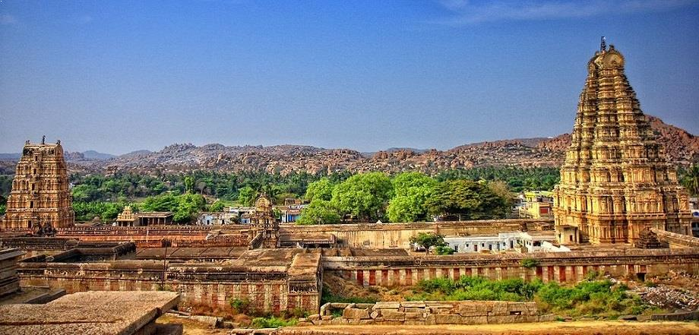
Virupaksha Temple, Hambi (KA)

Slide 9
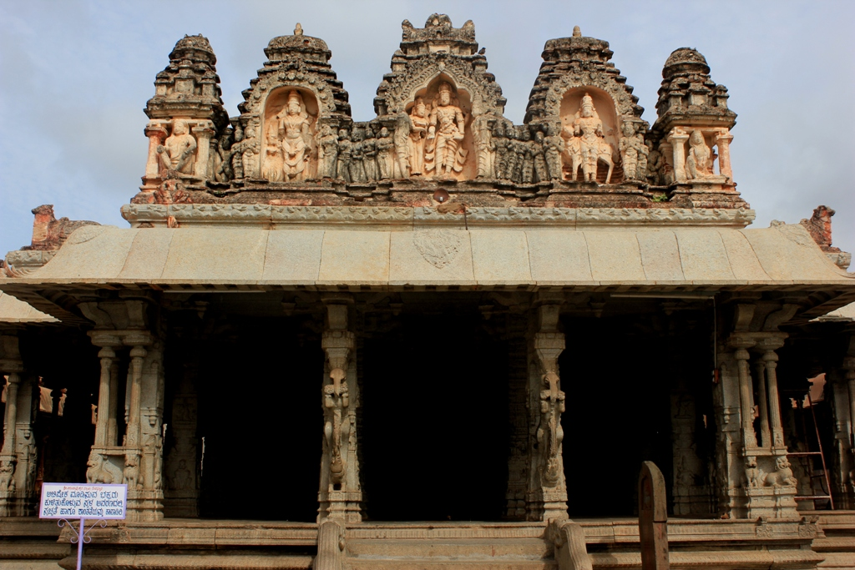
Ranga Mandapas, Hambi (KA)

Slide 10
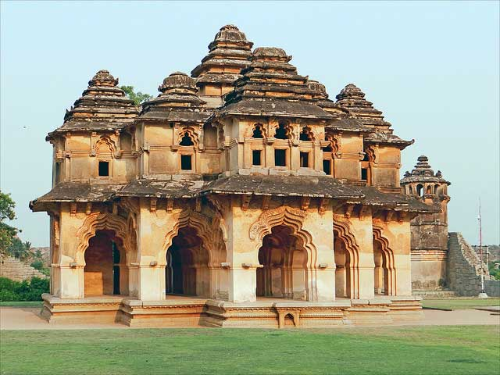
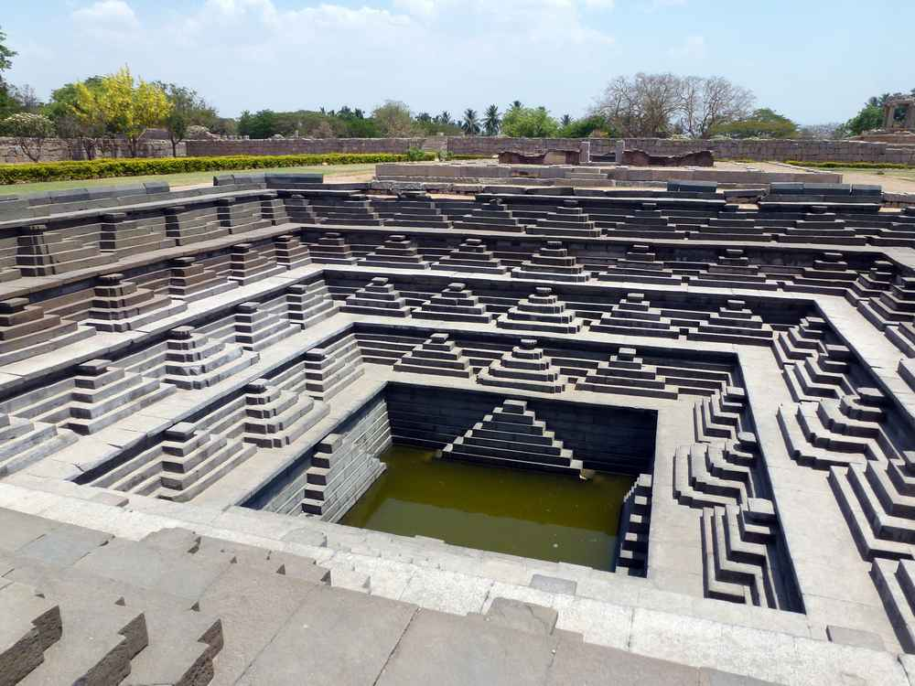
Lotus Temple, Hambi (KA)
Stepped Tank, Hambi(KA)

Slide 11
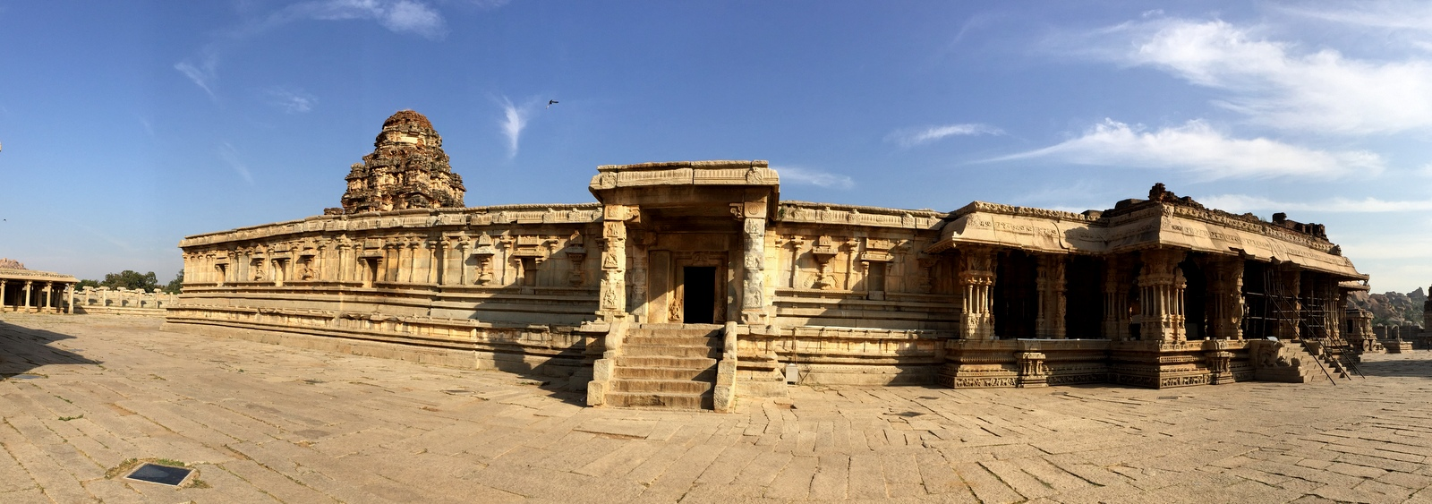
Vittala Temple at Hambi (KA)

Slide 12
Main Features
Construction of Amman Shrine in the Temple
Construction of Hundred Pillared Hall and Thousand pillared Hall in each and every temple
Sculpture decorations in pillars
Erection of highest tower at the entrance of the Temples
Construction of many prakaras, mandapas like kalyana mandapa, unjal mandapa, vasantha mandapa, vahana mandapa, ranga mandapa and kannadi manadapa.
Paintings in inner walls, ceilings and pillars.
Painting concept stories of Ramayana and Mahabharatha.

